Slide 1
Huffman Coding:
An Application of Binary Trees and Priority Queues
CS 102

Slide 2
Purpose of Huffman Coding
Proposed by Dr. David A. Huffman in 1952
  “A Method for the Construction of Minimum Redundancy Codes”
Applicable to many forms of data transmission
  Our example: text files
CS 102
Notes:
An Introduction to Huffman Coding
March 21, 2000
Mike Scott

Slide 3
The Algorithm
1. Scan text to be compressed and tally occurrence of all characters.
2. Sort or prioritize characters based on number of occurrences in text.
3. Build Huffman code tree based on prioritized list.
4. Perform a traversal of tree to determine all code words.
5. Scan text again and create new file using the Huffman codes.
CS 102
Notes:
An Introduction to Huffman Coding
March 21, 2000
Mike Scott

Slide 4
Encoding messages
Encode a message composed of a string of characters
Codes used by computer systems
  ASCII
    uses 8 bits per character
    can encode 256 characters
  Unicode
    16 bits per character
    can encode 65536 characters
    includes all characters encoded by ASCII
ASCII and Unicode are fixed-length codes
  all characters represented by same number of bits

Slide 5
Drawbacks of fixed-length codes
Wasted space
  Same number of bits used to represent all characters
Potential solution: use variable-length codes
  variable number of bits to represent characters when frequency of occurrence is known
  short codes for characters that occur frequently

Slide 6
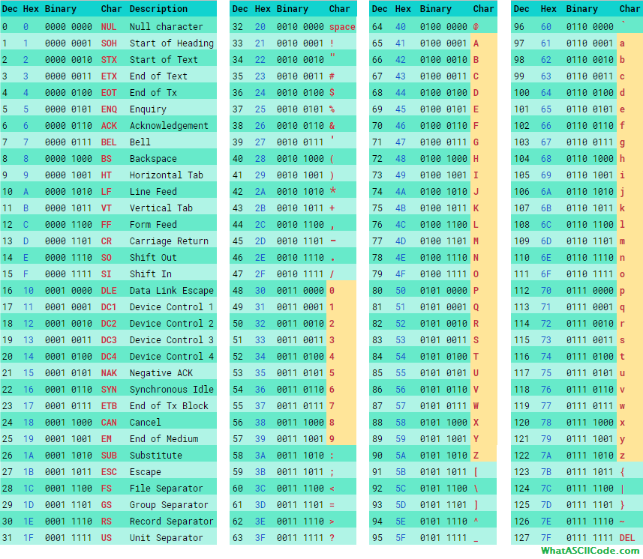

Slide 7
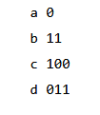
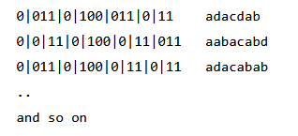
Variable Length Coding - Example
how do we know where one character ends and another begins?

Slide 8
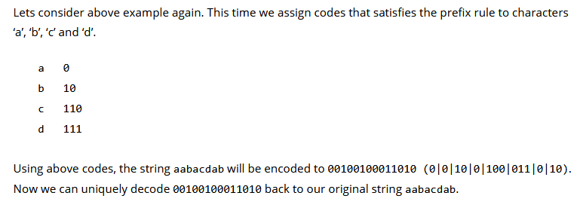
Prefix property
A code has the prefix property if no character code is the prefix (start of the code) for another character

Slide 9
Building a Tree
Scan the original text
Consider the following short text:
Eerie eyes seen near lake.
Count up the occurrences of all characters in the text
CS 102
Notes:
An Introduction to Huffman Coding
March 21, 2000
Mike Scott

Slide 10
Building a Tree
Scan the original text
Eerie eyes seen near lake.
What characters are present?
E e r i space
y s n a r l k .
CS 102
Notes:
An Introduction to Huffman Coding
March 21, 2000
Mike Scott

Slide 11
Building a Tree
Scan the original text
Eerie eyes seen near lake.
What is the frequency of each character in the text?
Char Freq. Char Freq. Char Freq.
E 1 y 1 k 1
e 8 s 2 . 1
r 2 n 2
i 1 a 2
space 4 l 1
CS 102
Notes:
An Introduction to Huffman Coding
March 21, 2000
Mike Scott

Slide 12
Building a Tree
Prioritize characters
Create binary tree nodes with character and frequency of each character
Place nodes in a priority queue
  The lower the occurrence, the higher the priority in the queue
CS 102
Notes:
An Introduction to Huffman Coding
March 21, 2000
Mike Scott

Slide 13
Building a Tree
Prioritize characters
Uses binary tree nodes
struct HuffNode
{
char myChar;
int myFrequency;
HuffNode *myLeft, *myRight;
}
CS 102
Notes:
An Introduction to Huffman Coding
March 21, 2000
Mike Scott

Slide 14
Building a Tree
The queue after inserting all nodes
Null Pointers are not shown
E
1
i
1
y
1
l
1
k
1
.
1
r
2
s
2
n
2
a
2
sp
4
e
8
CS 102
Notes:
An Introduction to Huffman Coding
March 21, 2000
Mike Scott

Slide 15
Building a Tree
While priority queue contains two or more nodes
  Create new node
  Dequeue node and make it left subtree
  Dequeue next node and make it right subtree
  Frequency of new node equals sum of frequency of left and right children
  Enqueue new node back into queue
CS 102
Notes:
An Introduction to Huffman Coding
March 21, 2000
Mike Scott

Slide 16
Building a Tree
E
1
i
1
y
1
l
1
k
1
.
1
r
2
s
2
n
2
a
2
sp
4
e
8
CS 102
Notes:
An Introduction to Huffman Coding
March 21, 2000
Mike Scott

Slide 17
Building a Tree
y
1
l
1
k
1
.
1
r
2
s
2
n
2
a
2
sp
4
e
8
2
E
1
i
1
CS 102
Notes:
An Introduction to Huffman Coding
March 21, 2000
Mike Scott

Slide 18
Building a Tree
y
1
l
1
k
1
.
1
r
2
s
2
n
2
a
2
2
sp
4
e
8
E
1
i
1
CS 102
Notes:
An Introduction to Huffman Coding
March 21, 2000
Mike Scott

Slide 19
Building a Tree
k
1
.
1
r
2
s
2
n
2
a
2
2
sp
4
e
8
E
1
i
1
2
y
1
l
1
CS 102
Notes:
An Introduction to Huffman Coding
March 21, 2000
Mike Scott

Slide 20
Building a Tree
k
1
.
1
r
2
s
2
n
2
a
2
2
2
sp
4
e
8
y
1
l
1
E
1
i
1
CS 102
Notes:
An Introduction to Huffman Coding
March 21, 2000
Mike Scott

Slide 21
Building a Tree
r
2
s
2
n
2
a
2
2
2
sp
4
e
8
y
1
l
1
E
1
i
1
2
k
1
.
1
CS 102
Notes:
An Introduction to Huffman Coding
March 21, 2000
Mike Scott

Slide 22
Building a Tree
r
2
s
2
n
2
a
2
2
2
sp
4
e
8
2
E
1
i
1
y
1
l
1
k
1
.
1
CS 102
Notes:
An Introduction to Huffman Coding
March 21, 2000
Mike Scott

Slide 23
Building a Tree
n
2
a
2
2
sp
4
e
8
2
2
E
1
i
1
y
1
l
1
k
1
.
1
4
r
2
s
2
CS 102
Notes:
An Introduction to Huffman Coding
March 21, 2000
Mike Scott

Slide 24
Building a Tree
n
2
a
2
2
sp
4
e
8
2
2
4
E
1
i
1
y
1
l
1
k
1
.
1
r
2
s
2
CS 102
Notes:
An Introduction to Huffman Coding
March 21, 2000
Mike Scott

Slide 25
Building a Tree
2
4
e
8
2
2
sp
4
y
1
l
1
k
1
.
1
r
2
s
2
E
1
i
1
4
n
2
a
2
CS 102
Notes:
An Introduction to Huffman Coding
March 21, 2000
Mike Scott

Slide 26
Building a Tree
2
4
4
e
8
2
2
sp
4
y
1
l
1
k
1
.
1
r
2
s
2
n
2
a
2
E
1
i
1
CS 102
Notes:
An Introduction to Huffman Coding
March 21, 2000
Mike Scott

Slide 27
Building a Tree
4
4
e
8
2
sp
4
k
1
.
1
r
2
s
2
n
2
a
2
4
2
2
E
1
i
1
y
1
l
1
CS 102
Notes:
An Introduction to Huffman Coding
March 21, 2000
Mike Scott

Slide 28
Building a Tree
2
4
4
4
sp
4
e
8
2
2
k
1
.
1
r
2
s
2
n
2
a
2
E
1
i
1
y
1
l
1
CS 102
Notes:
An Introduction to Huffman Coding
March 21, 2000
Mike Scott

Slide 29
Building a Tree
4
4
4
e
8
2
2
r
2
s
2
n
2
a
2
E
1
i
1
y
1
l
1
6
2
sp
4
k
1
.
1
CS 102
Notes:
An Introduction to Huffman Coding
March 21, 2000
Mike Scott

Slide 30
Building a Tree
4
4
4
6
e
8
2
sp
4
r
2
s
2
n
2
a
2
2
2
k
1
.
1
E
1
i
1
y
1
l
1
What is happening to the characters with a low number of occurrences?
CS 102
Notes:
An Introduction to Huffman Coding
March 21, 2000
Mike Scott

Slide 31
Building a Tree
4
6
e
8
2
2
2
sp
4
E
1
i
1
y
1
l
1
k
1
.
1
8
4
4
r
2
s
2
n
2
a
2
CS 102
Notes:
An Introduction to Huffman Coding
March 21, 2000
Mike Scott

Slide 32
Building a Tree
4
6
e
8
8
2
2
2
sp
4
4
4
E
1
i
1
y
1
l
1
k
1
.
1
r
2
s
2
n
2
a
2
CS 102
Notes:
An Introduction to Huffman Coding
March 21, 2000
Mike Scott

Slide 33
Building a Tree
e
8
8
4
4
10
r
2
s
2
n
2
a
2
4
6
2
2
2
sp
4
E
1
i
1
y
1
l
1
k
1
.
1
CS 102
Notes:
An Introduction to Huffman Coding
March 21, 2000
Mike Scott

Slide 34
Building a Tree
e
8
8
10
4
4
4
6
n
2
a
2
2
2
2
r
2
s
2
sp
4
E
1
i
1
y
1
l
1
k
1
.
1
CS 102
Notes:
An Introduction to Huffman Coding
March 21, 2000
Mike Scott

Slide 35
Building a Tree
10
16
4
6
2
2
2
e
8
8
sp
4
E
1
i
1
y
1
l
1
k
1
.
1
4
4
r
2
s
2
n
2
a
2
CS 102
Notes:
An Introduction to Huffman Coding
March 21, 2000
Mike Scott

Slide 36
Building a Tree
10
16
4
6
e
8
8
2
2
2
sp
4
4
4
E
1
i
1
y
1
l
1
k
1
.
1
r
2
s
2
n
2
a
2
CS 102
Notes:
An Introduction to Huffman Coding
March 21, 2000
Mike Scott

Slide 37
Building a Tree
26
16
10
4
e
8
8
6
2
2
2
sp
4
4
4
E
1
i
1
y
1
l
1
k
1
.
1
r
2
s
2
n
2
a
2
CS 102
Notes:
An Introduction to Huffman Coding
March 21, 2000
Mike Scott

Slide 38
Building a Tree
After enqueueing this node there is only one node left in priority queue.
26
16
10
4
e
8
8
6
2
2
2
sp
4
4
4
E
1
i
1
y
1
l
1
k
1
.
1
r
2
s
2
n
2
a
2
CS 102
Notes:
An Introduction to Huffman Coding
March 21, 2000
Mike Scott

Slide 39
Building a Tree
Dequeue the single node left in the queue.
This tree contains the new code words for each character.
Frequency of root node should equal number of characters in text.
26
16
10
4
e
8
8
6
2
2
2
4
sp
4
4
E
1
i
1
y
1
l
1
k
1
.
1
r
2
s
2
n
2
a
2
Eerie eyes seen near lake.  26 characters
CS 102
Notes:
An Introduction to Huffman Coding
March 21, 2000
Mike Scott

Slide 40
Encoding the File
Traverse Tree for Codes
Perform a traversal of the tree to obtain new code words
Going left is a 0 going right is a 1
code word is only completed when a leaf node is reached
26
16
10
4
e
8
8
6
2
2
2
4
sp
4
4
E
1
i
1
y
1
l
1
k
1
.
1
r
2
s
2
n
2
a
2
CS 102
Notes:
An Introduction to Huffman Coding
March 21, 2000
Mike Scott

Slide 41
Encoding the File
Traverse Tree for Codes
Char Code
E 0000
i 0001
y 0010
l 0011
k 0100
. 0101
space 011
e 10
r 1100
s 1101
n 1110
a 1111
26
16
10
4
e
8
8
6
2
2
2
4
sp
4
4
E
1
i
1
y
1
l
1
k
1
.
1
r
2
s
2
n
2
a
2
CS 102
Notes:
An Introduction to Huffman Coding
March 21, 2000
Mike Scott

Slide 42
Encoding the File
Rescan text and encode file using new code words
Eerie eyes seen near lake.
Char Code
E 0000
i 0001
y 0010
l 0011
k 0100
. 0101
space 011
e 10
r 1100
s 1101
n 1110
a 1111
0000101100000110011100010101101101001111101011111100011001111110100100101
Why is there no need for a separator character?
.
CS 102
Notes:
An Introduction to Huffman Coding
March 21, 2000
Mike Scott

Slide 43
Encoding the File
Results
Have we made things any better?
73 bits to encode the text
ASCII would take 8 * 26 = 208 bits
0000101100000110011100010101101101001111101011111100011001111110100100101
If modified code used 4 bits per
character are needed. Total bits
4 * 26 = 104. Savings not as great.
CS 102
Notes:
An Introduction to Huffman Coding
March 21, 2000
Mike Scott

Slide 44
Decoding the File
Once receiver has tree it scans incoming bit stream
0 ⇒ go left
1 ⇒ go right
26
16
10
4
e
8
8
6
2
2
2
4
sp
4
4
10100011011110111101111110000110101
E
1
i
1
y
1
l
1
k
1
.
1
r
2
s
2
n
2
a
2
CS 102

Slide 45
Summary
Huffman coding is a technique used to compress files for transmission
Uses statistical coding
  more frequently used symbols have shorter code words
Works well for text and fax transmissions
An application that uses several data structures
CS 102

Slide 46
Example: How to label edges
19
8
11
4
4
6
5
S
2
2
2
2
3
3
E
H
_
I
1
1
1
1
A
G
M
T

Slide 47
Label edges
19
0
1
8
11
0
1
0
1
4
4
6
5
0
1
0
1
0
1
S
2
2
2
2
3
3
0
1
0
1
E
H
_
I
1
1
1
1
A
G
M
T

